Slide 1
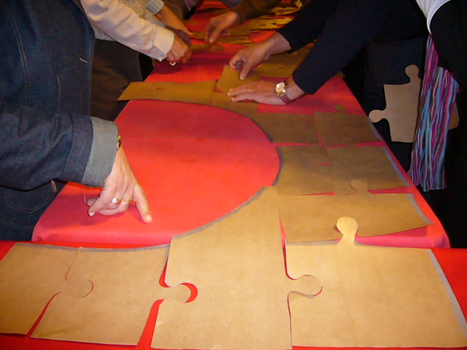
a short view on the history
Our way to the ICDS statutes

Slide 2
A short view on the ICDS history
1st international meeting of members of all three branches in Rome
3rd international meeting of members of all three branches in Rome
First common thoughts about where the journey should go to and what will be needed.
2nd international meeting of members of all three branches in Sao Paolo
1990
t
1992
2003

Slide 3
A short view on the ICDS history
1st General Assembly in Rome
Agreement about common name.
Official start on the stautes work
Submission
of the necessary
documents at the office
of the
Pontifical Council for the Laity
(later Dicastery for Laity, Family & Life)
The approval of the
submitted statutes
by the GA 2012
and thus come into force
a private association of faithful was founded
2006
t
2011
2012

Slide 4
A short view on the ICDS history
Collecting info about ICDS apostolates
from the units
1st Feedback by the Dicastery.
3rd face to face
meeting with
Dr. Milligan
2nd revised and significantly enlarged version of the draft statutes was returned to the dicastery
2nd Feedback by the Dicastery
still some things are to change and we have to find our own wording for some phrases
3rd General Assambly
Data Protection Regulation became necessary and thus attentiveness
1. Meeting with
Dr. Milligan
installing a permanent contact person for the dicastery
installing a workgroup for the statutes
2013
t
2015
2017
2018

Slide 5
A short view on the ICDS history
Again a meeting
with the dicastry
some significant improvements were requested, including the involvement of units
The safeguarding policy has to be worked out and implemented
The Congregation of Doctrine and Faith has granted its nihil obstat to the statutes.
But in addition to some minor textual improvements, a new decree of the dicastery required again drastic and far-reaching changes
A letter with a reasoned request for some exceptions was written - but without success.
We had to comply with the specifications.
the finished draft of the statutes got sent to the dicastery
Again a revised and significantly enlarged version of the draft statutes was returned to the dicastery
2019
t
2020
2021
July
2021
Oct.

Slide 6
A short view on the ICDS history
The final revision to the Statutes of the ICDS was approved
The official foundation date of the
International Community of the Divine Savior
is
December 8, 2022.
waiting
&
hoping
The ceremony of recognition of the ICDS
as an
International Private Association of the Faithful,
dotted with juridical personality
will take place on Feb. 8.
2022
Sept.
t
2023
Feb.

Slide 7
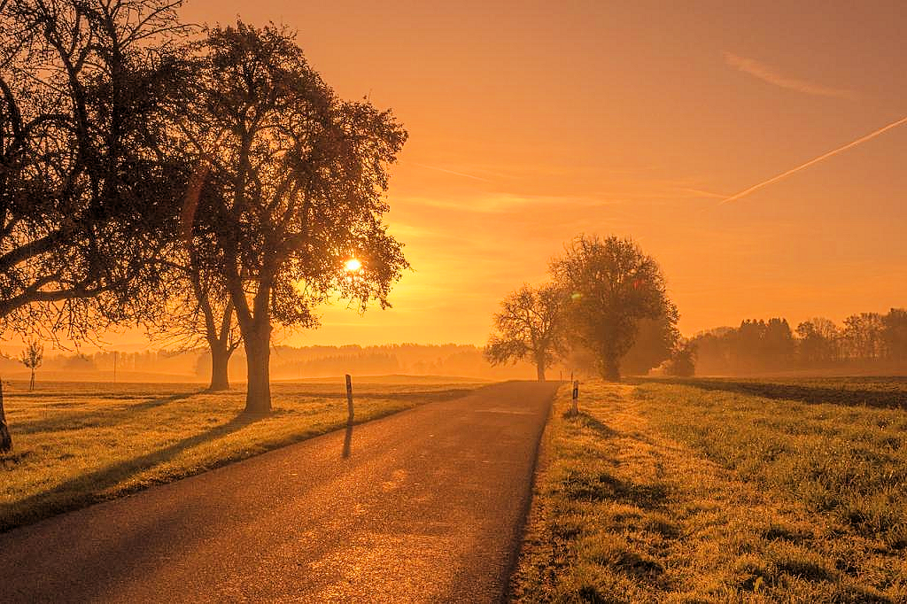
There is a long way behind us
and hopefully a much longer one in front of us

Slide 8
A text by Kenzia Drake ICDS is available for this presentation.
Text, Graphic and Design
by
Christian Patzl ICDS
All rights reserved.

