Slide 1

An unusual view
from the perspective of the third branch
and how present the Holy Spirit is.
Christian Patzl CDS

Slide 2
Topics
The metaphor of the Salvatorian tree
Living in the presence –
what is important today?
Attempting to find a reply –
Let you be ignited ...
Thoughts on the future –
what is needed?

Slide 3

The metaphor of the Salvatorian tree

Slide 4
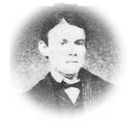


The metaphor of the Salvatorian tree

Slide 5

The metaphor of the Salvatorian tree
The original vision
Scientists
Teacher
Clerics
Men
Women
Parents
Youth & Children
Politicans
Workers
3 Grades

Slide 6




The metaphor of the Salvatorian tree
... and what the outcome was ...
Scientists
Teacher
Clerics
Men
Women
Parents
Youth & Children
Politicans
Workers
3 Grades

Slide 7

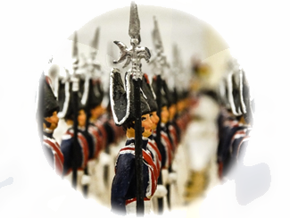

The metaphor of the Salvatorian tree
upright
grown straight
according to the picture of human imagination

Slide 8

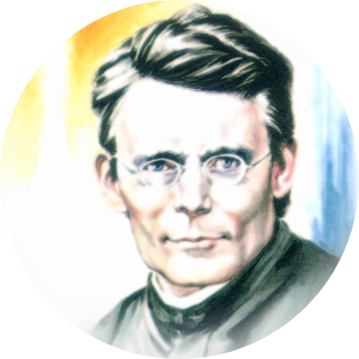
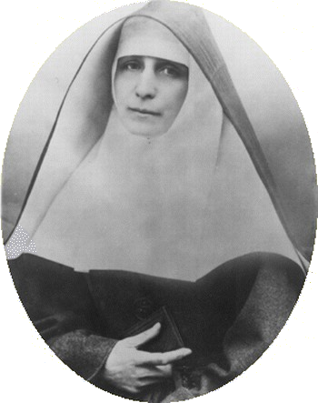

The metaphor of the Salvatorian tree
Sisters of the Sorrowful Mother -
Addolorata sisters
Sr. Franziska (Amalia) Streitel
1844 - 1911

Slide 9
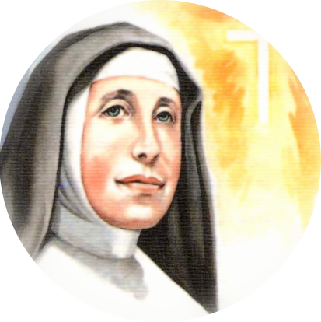

The metaphor of the Salvatorian tree
Sor DS
Soc DS

Slide 10


The metaphor of the Salvatorian tree
2.Vatican Council

Slide 11




The metaphor of the Salvatorian tree
Salvatorian Family

Slide 12


The metaphor of the Salvatorian tree
Salvatorian Family

Slide 13
Topics
The metaphor of the Salvatorian tree
Living in the presence –
what is important today?
Attempting to find a reply –
Let you be ignited ...
Thoughts on the future –
what is needed?

Slide 14

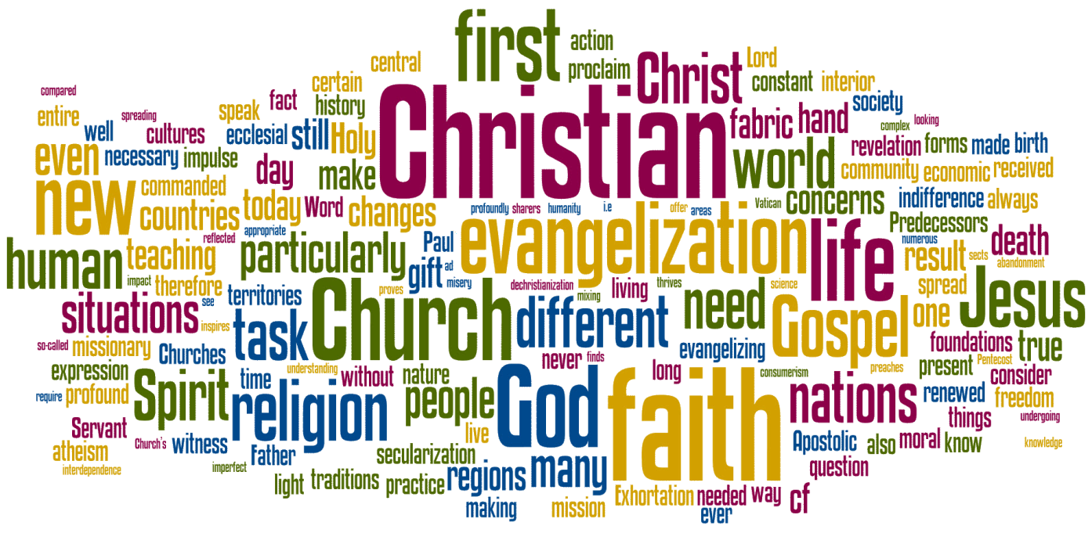
Living in the present -
what is important today?
Evangelization which is understood ...

Slide 15



Living in the present -
what is important today?
Welcome to the general rat race ...
... you are part of it
– also if you don't believe it at the moment!

Slide 16

Living in the present -
what is important today?
Reinvigorated captalism exploits the humans and degenerates them to machines.

Slide 17

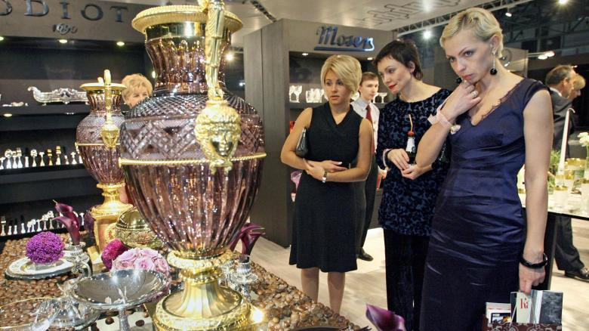
Living in the present -
what is important today?
Some have all ...
... and some nearly nothing.

Slide 18

Living in the present -
what is important today?
My soul
– where are you,
- where have I left you behind?

Slide 19

Living in the present -
what is important today?
The tale from the soul which was left behind

Slide 20
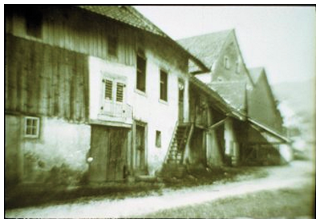
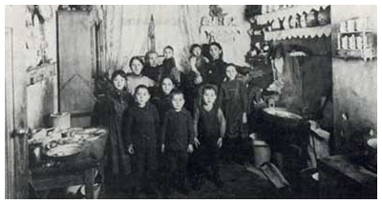
Living in the presence –
a fLashback
Birth house of
John Baptist Jordan
at Gurtweil/Germany
Example for the housing
conditions of poor Families
in Europe before 1900

Slide 21
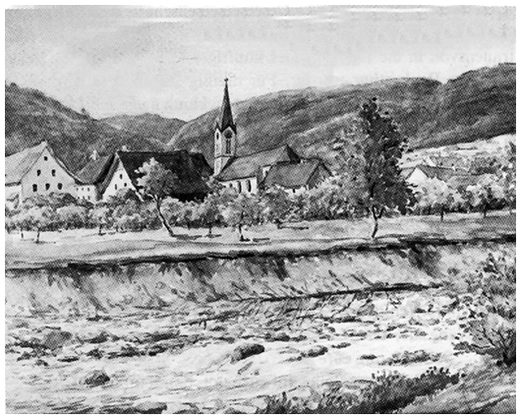
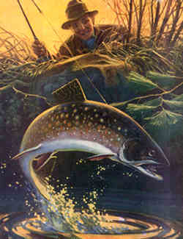
Living in the presence –
a fLashback
Drawing of
Gurtweil/Germany
with the river Schlücht

Slide 22
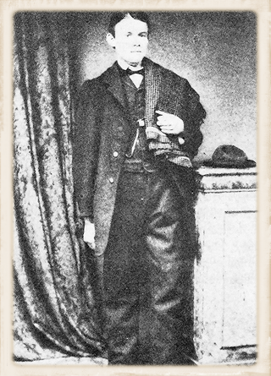
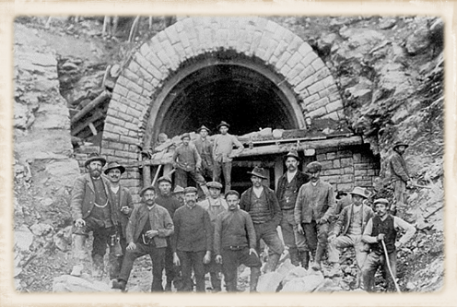
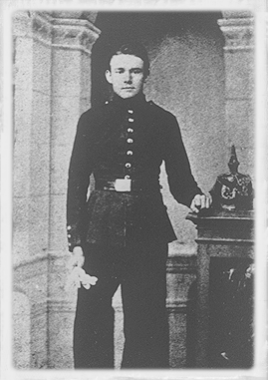
Living in the presence –
a fLashback
John Baptist Jordan
as a journeyman
at the railway construction
as a soldier

Slide 23
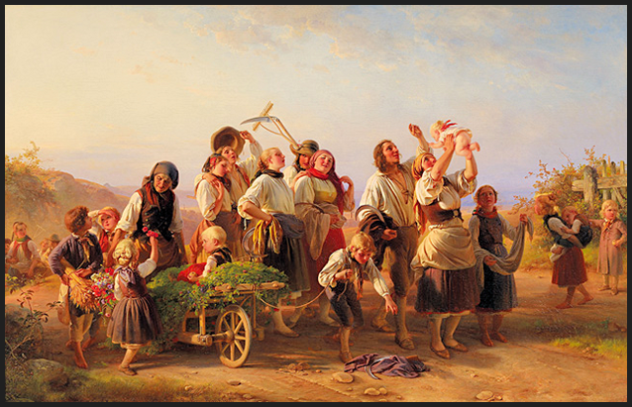
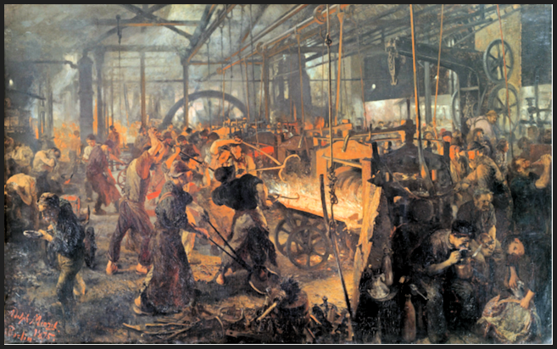
Living in the presence –
a fLashback
If on a farm or in a factory ...
... people had to work > 12 hours a day!

Slide 24
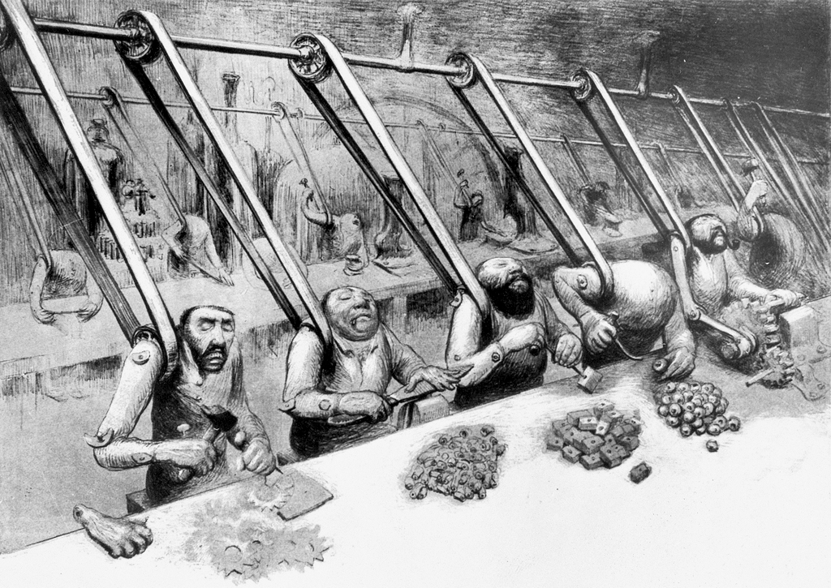
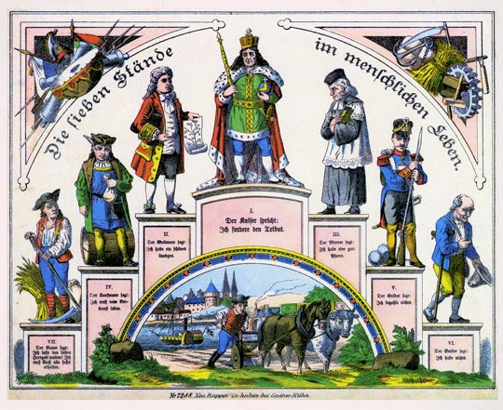
Living in the presence –
a fLashback
„The Divine Order“
„Machine people“
Contemporary caricature

Slide 25


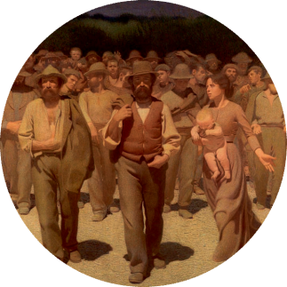
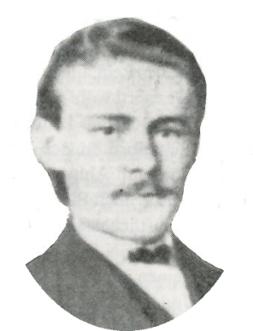
Universal Vision ...
Field of tension
Living in the presence –
a fLashback
יהוה
a
universal
work
call
answer
call
answer
realize
realize

Slide 26

Living in the presence –
a fLashback
The Hl. Spirit cannot force back by human regulations and limits.
Fr. Jordan‘s efforts were only the beginning
of a comprehensive process:
„Others will come,
they will remember our suffering
and continue our work“
Words of Fr. Jordan

Slide 27



Living in the presence-
what is needed ...
open mind
unconventional
joint-up
People who think ...

Slide 28

Living in the presence -
challenges
Interesting questions:
What is the value of faith?
What does it provide, what do I gain?
Are there benefits for me?

Slide 29
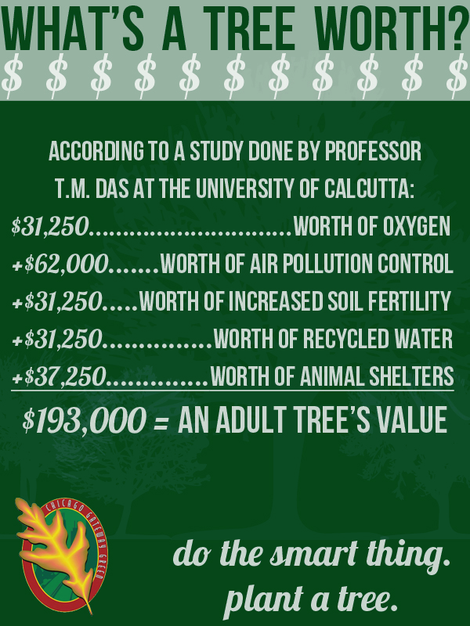

Living in the presence - challenges
What is the value of ... ?

Slide 30

Living in the presence - challenges
„One does not live by bread alone ...“
Mat 4,4
- and the work is not the only sense
of a human‘s life.

Slide 31
Topics
The metaphor of the Salvatorian tree
Living in the presence –
What is important today?
Attempting to find a reply –
Let you be ignited ...
Thoughts on the future –
what is needed?

Slide 32
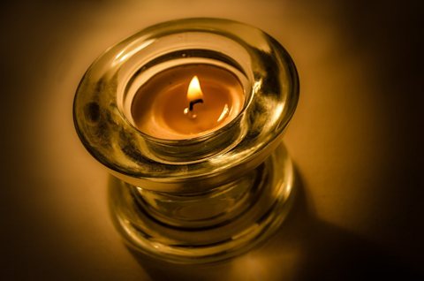
Attempting to find a reply
Let you be ignited ...

Slide 33
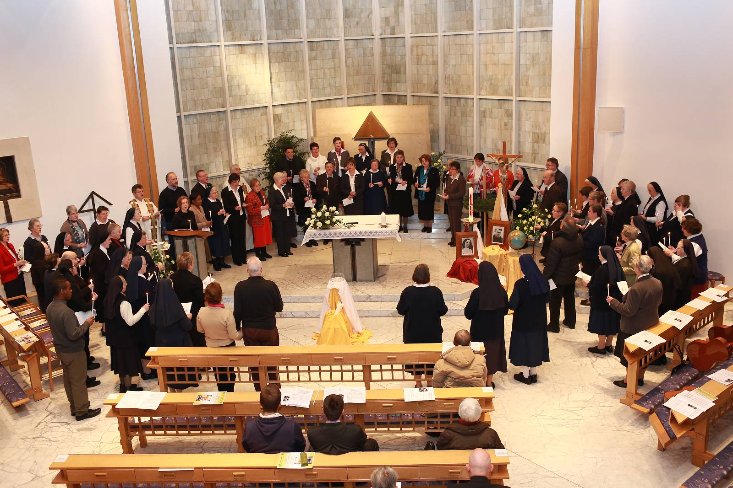
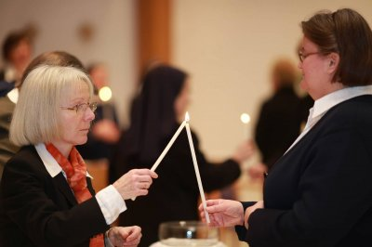
Attempting to find a reply
Let you be ignited ...

Slide 34
Topics
The metaphor of the Salvatorian tree
Living in the presence –
What is important today?
Attempting to find a reply –
Let you be ignited ...
Thoughts on the future –
what is needed?

Slide 35
Thoughts on the future –
what is needed
Coming back to the metaphor of the Salvatorian tree

Slide 36
Thoughts on the future –
what is needed
A view of the third Salvatorian branch

Slide 37
Thoughts on the future –
what is needed
Lay Salvatorians
- have their own vocation.
- will also exist on places where no Salvatorian religious are nearby.
- will fulfill the Salvatorian mission as Apostles of our time in the family, on workplace, in the neighborhood, and everywhere where they recognize the need to engage themselves.
Lay Salvatorian FAQ‘s

Slide 38

Thoughts on the future –
what is needed
Community
- to become heart and soul with
our brothers and sisters

Slide 39




Up-to-date
with modern media
Internet

Slide 40
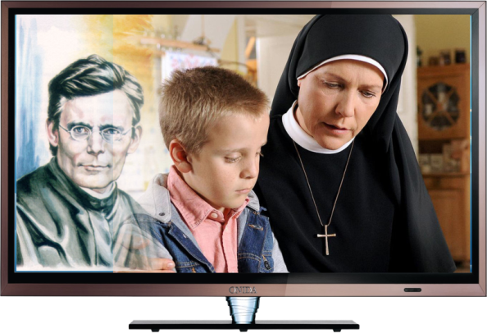
Up-to-date
with modern media
Suggestion:
Salvatorian Clips
Illustrating challenges, realities, ups and downs of Salvatorian Family members
E.g. - how a lived faith is challenging our daily life and how a good interaction between different religions could be possible

Slide 41

Up-to-date
with modern media
Be honest!
How many pages of the Salvatorian Family on the Internet did you visit already?
How many from other units?
www.laysalvatorians.org/update

Slide 42

Language barrier
We need to find ways to overcome it!

Slide 43

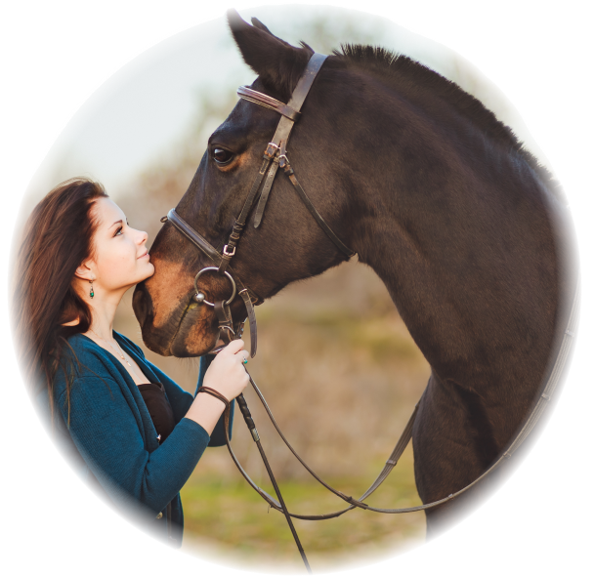
Give space the third branch
attention on possible synergies
and hidden talents
On equal level –
it‘s often not easy
to be reached in reality

Slide 44
Thoughts on the future –
what is needed
Coming back to the metaphor of the Salvatorian tree

Slide 45


Thoughts on the future –
what is needed

Slide 46
Thoughts on the future –
what is needed
“As long as there is one person on earth ... - we do not have any moment to rest to bring our flame, our faith and trust to our next,”
Always be ready to give an explanation to anyone who asks you for a reason of your hope, but do it with gentleness and reverence, keeping your conscience clear, ...”
1Pete 3,15-17

